Slide 1

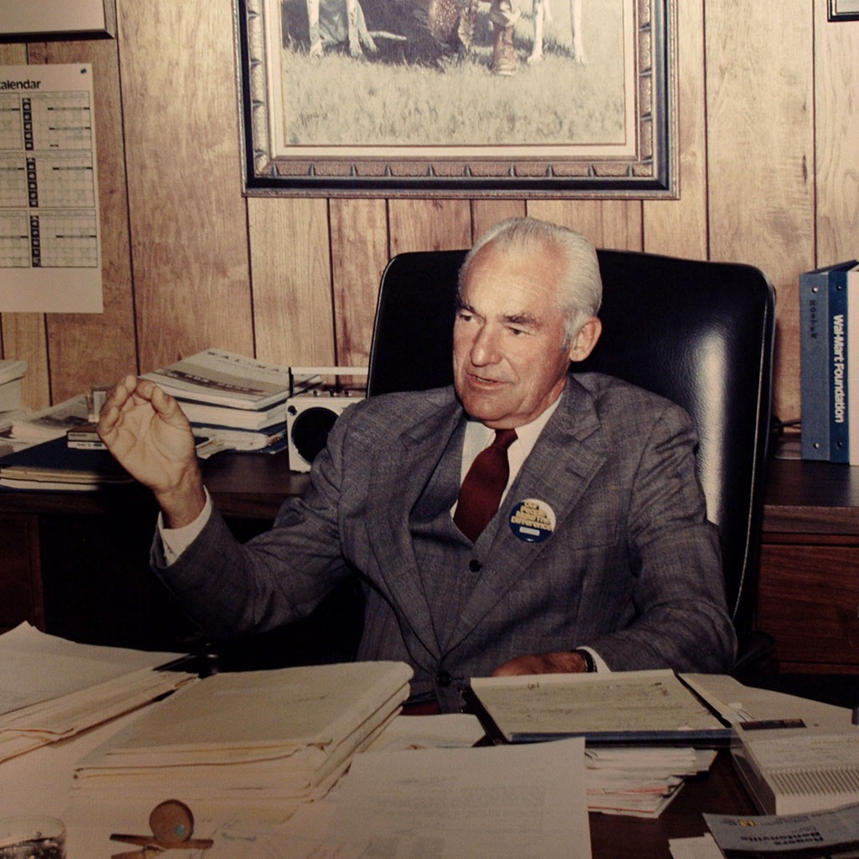
“If I had to single out one element in my life that has made a difference for me, it would be Passion to Compete.”
― Sam Walton
Book: Sam Walton - Made In America

Slide 2
IE6700 20991 Data Management for Analytics
SEC 05 Fall 2022
Walmart Economic Model
Group 07
SANIDHYA MATHUR
RAHUL SAI JANGILI

Slide 3
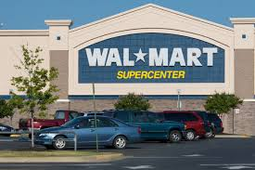

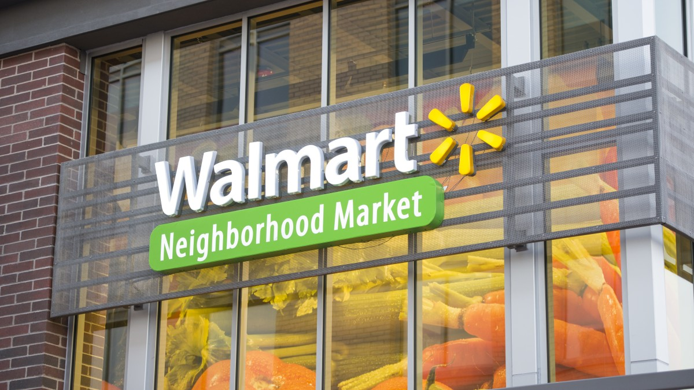
Walmart Retail Stores
Discount Stores
Neighbourhood Markets
Walmart E-Commerce
Supercenters
1962
1988
1998
2008

Slide 4
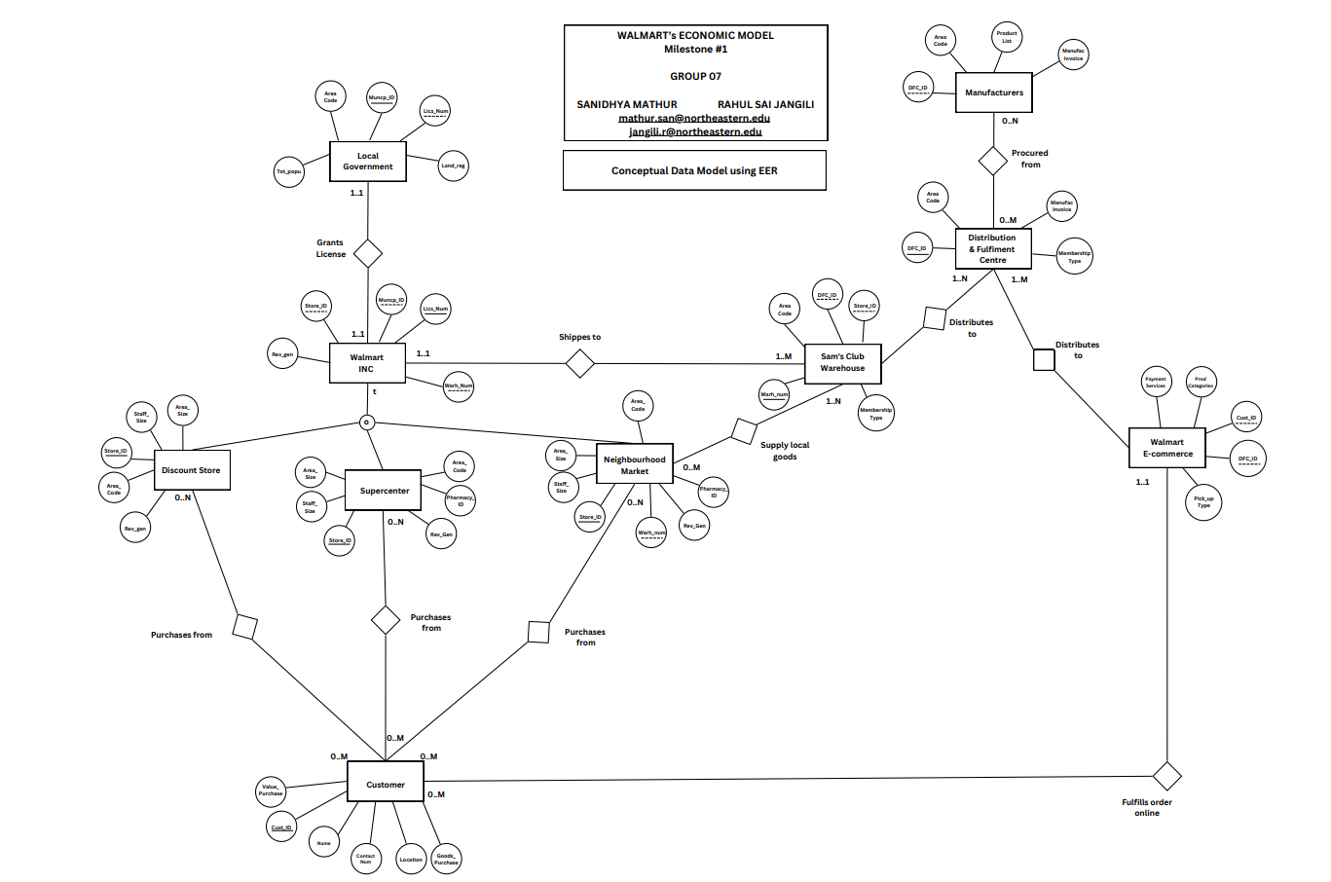
Conceptual Model using
E E R

Slide 5
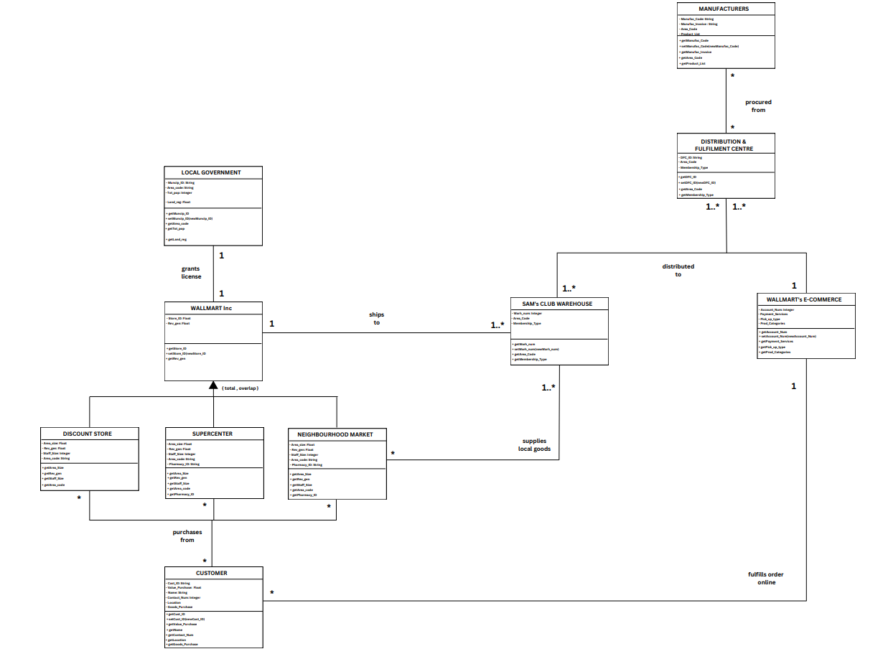
Conceptual Model using
U M L

Slide 6
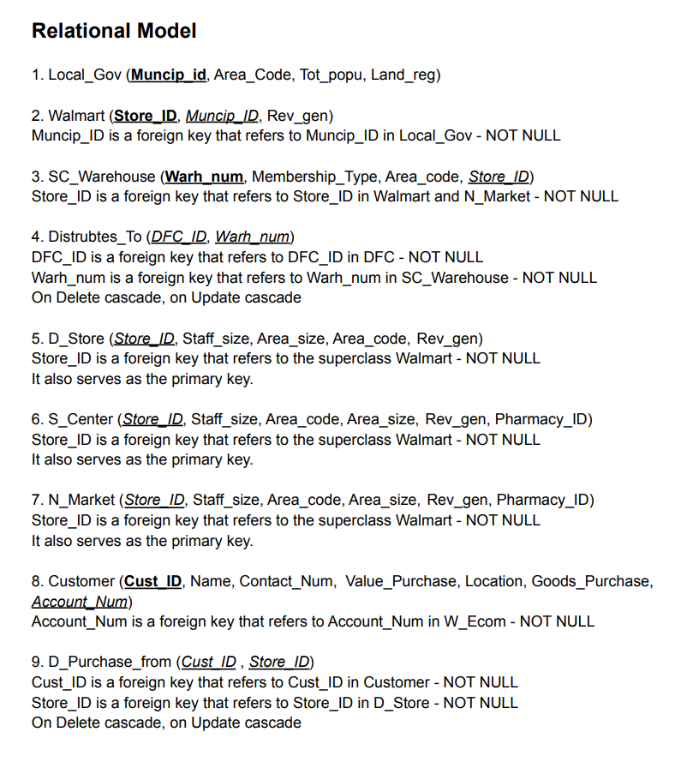
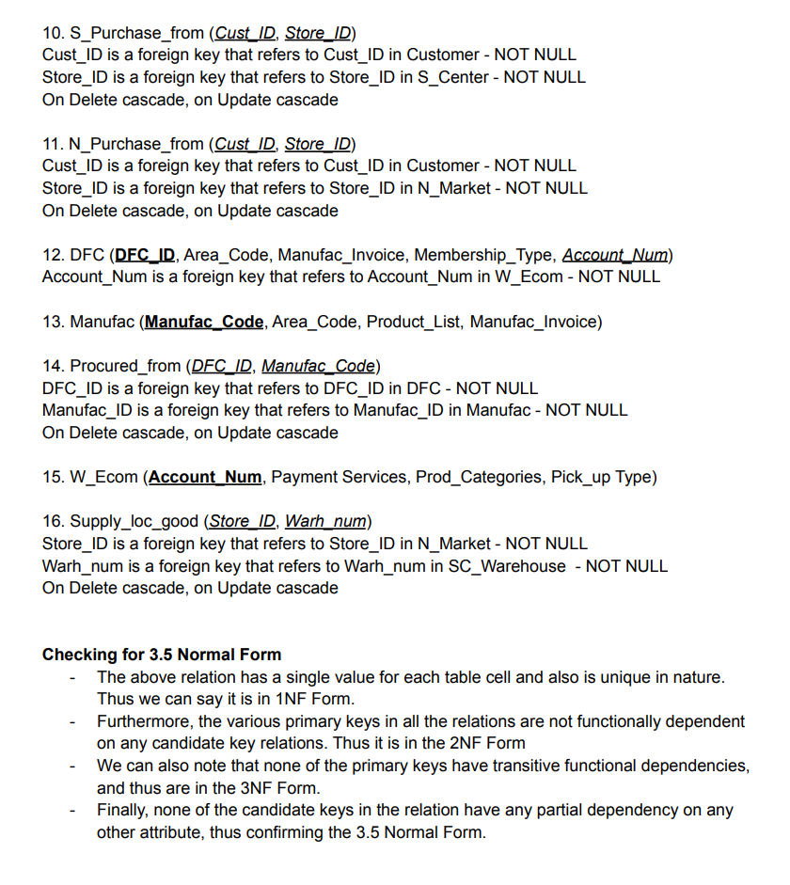

Slide 7
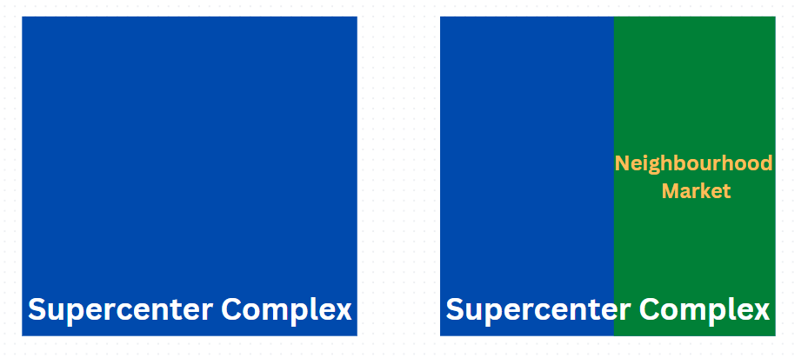
Neighbourhood Market ~ Easy access to local goods, products, groceries and much more
~ Located within the premises of Supercenter Complex
Till date, only a few (10 in our case) Supercenters have Neighbourhood Markets
The Board of Directors wants to compare and explore the impact on the Number of Footfalls and Total Revenue Generated in SCs with NMs & those without it.

Slide 8
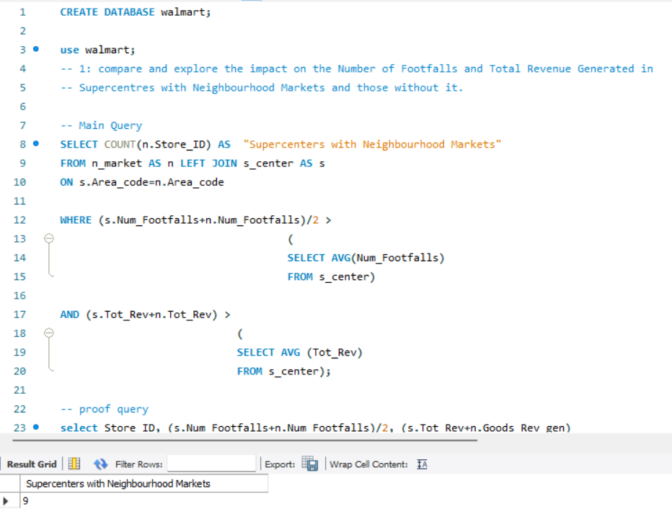
The Board of Directors now wants pinpoint the particular SC with NM which is underperforming.
So out of the Total of 10 SCs with NMs,
9 satisfy the condition of having Footfall and Revenue more than that of SCs without NMs.
Thus, we can conclude that having NMs within the premises of SCs certainly boosts the number of footfalls and total revenue of the SC complex.

Slide 9
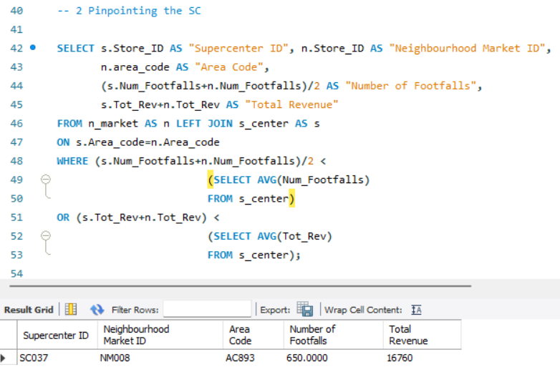
The Board of Directors now wants to open more NM in SC premises, BUT which ones to choose first?
SC037 which hosts NM008
No. of Footfalls = 650 Total Revenue as $16.7k
Threshold Revenue = $12.5k
No. of footfalls = 694
Falls short by 44 of the benchmark of 694 footfalls.

Slide 10
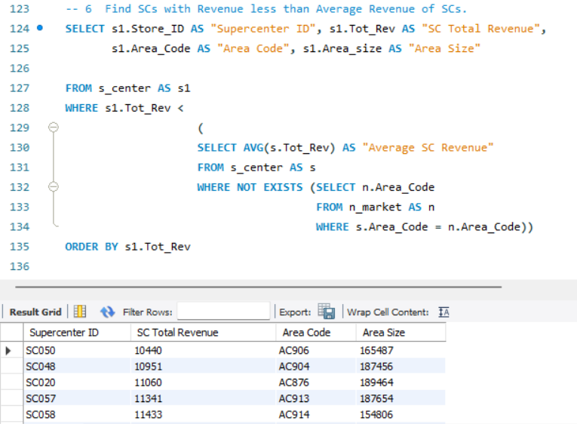
The Board notes down the SCs having Revenue lower than the Average Revenue of SCs without NMs.
They are confident that by inclusion of NMs into the premises of these SCs will boost Number of Footfalls and in-turn also the Total Revenue of the SCs.

Slide 11
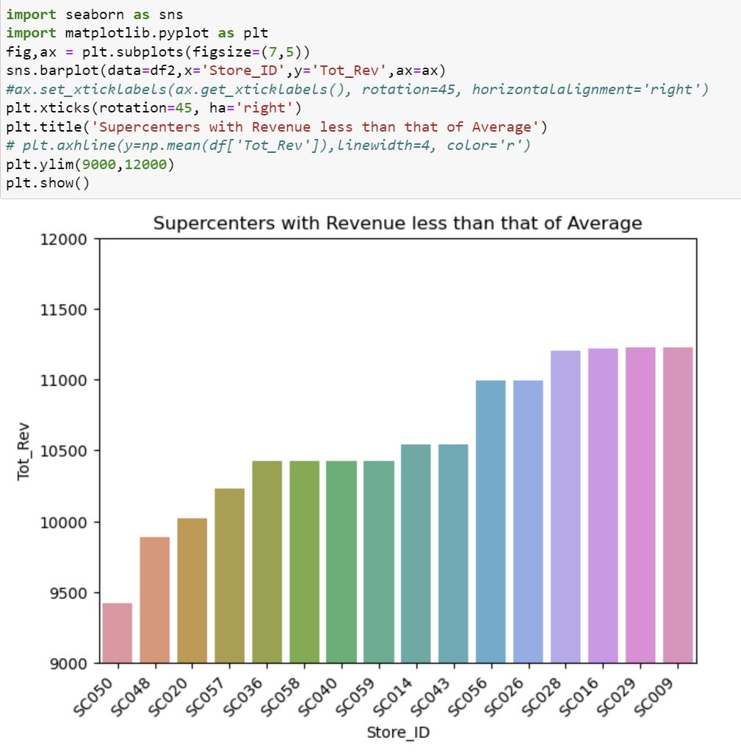

Slide 12
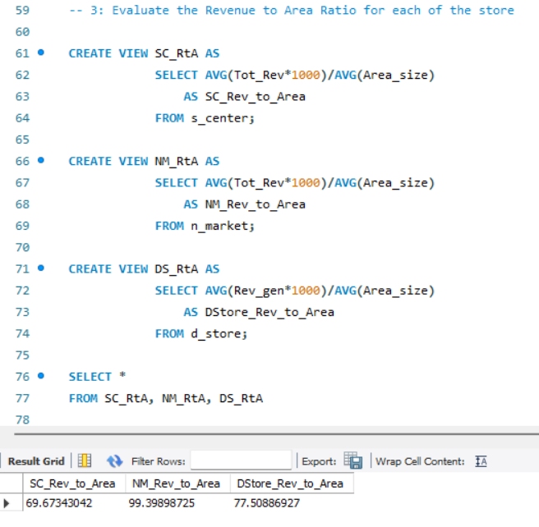
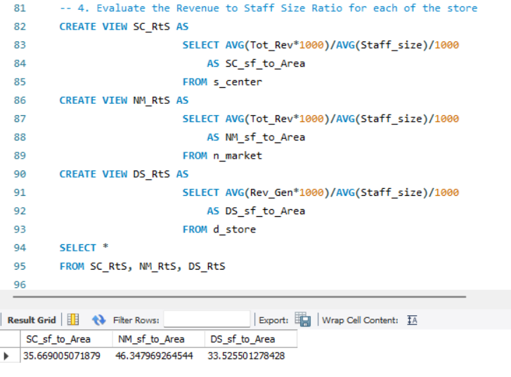
RtA Parameter
Revenue to Area Ratio
RtS Parameter
Revenue to Staff Size Ratio

Slide 13
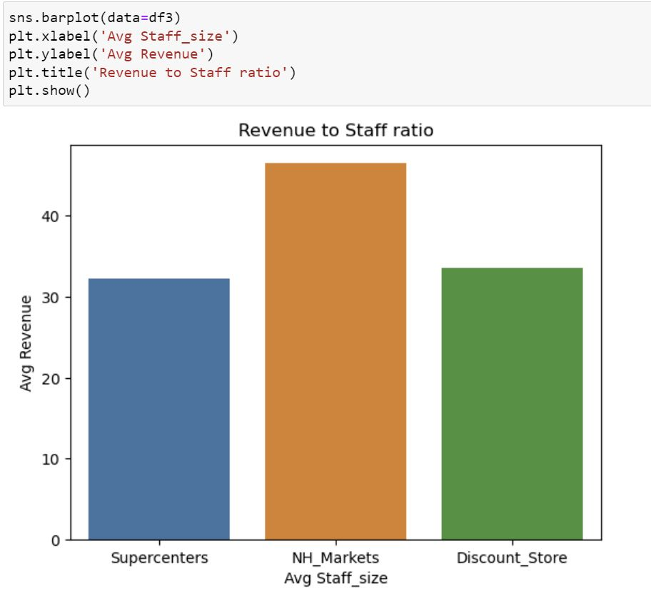
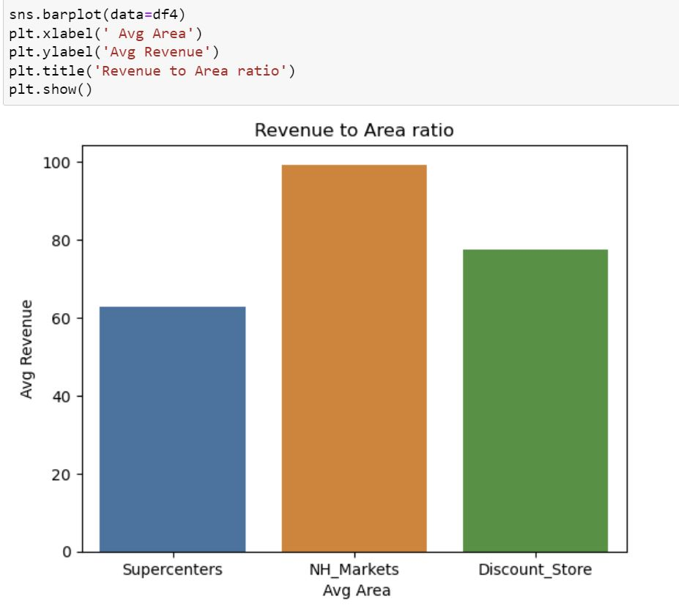

Slide 14
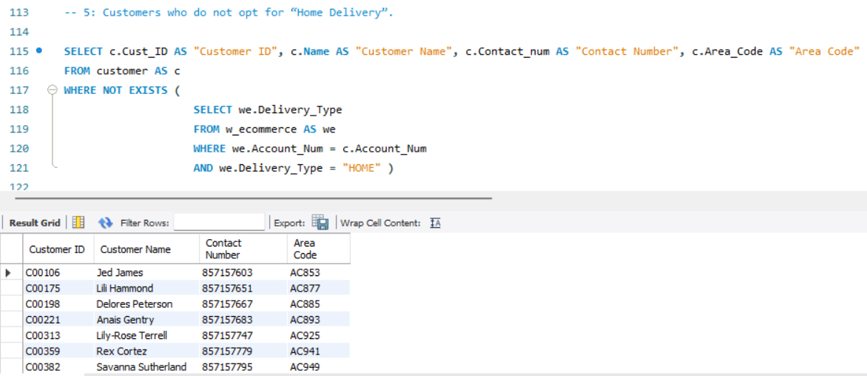
Walmart Ecommerce – Board directs the Communication department to contact the above customers for a survey “What attracts you to choose for options other than Home delivery” and in return they get reward points for future shopping. This survey is then used to improve the attractive factors and pull more customers away from Home Delivery to other options (UPS, Fed-Ex, In-Store).

Slide 15
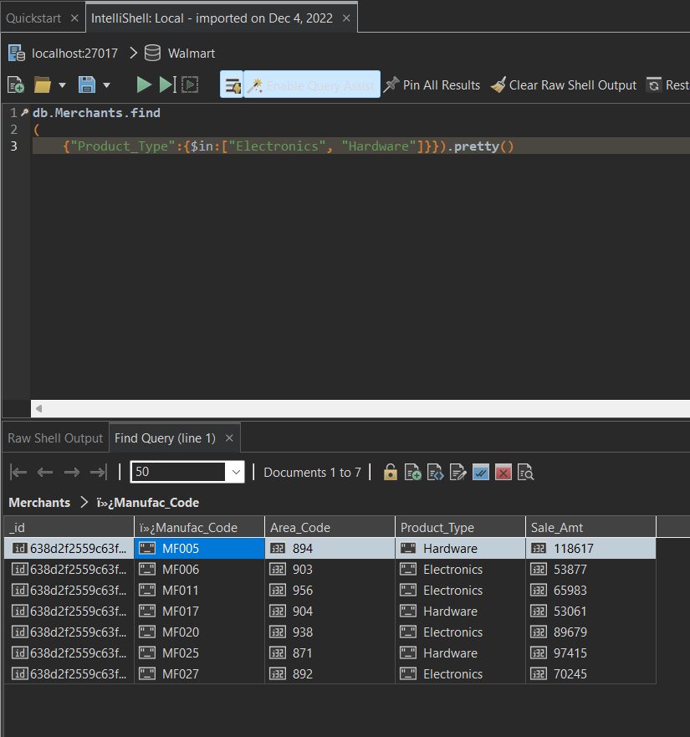

Christmas Vacation is coming up in a few days and customers want to buy DIY products for their house decorations. This demand from consumers has pushed the Board to procure more electronics & hardware goods from merchants.
Finding Merchants selling Electronics or Hardware products.

Slide 16
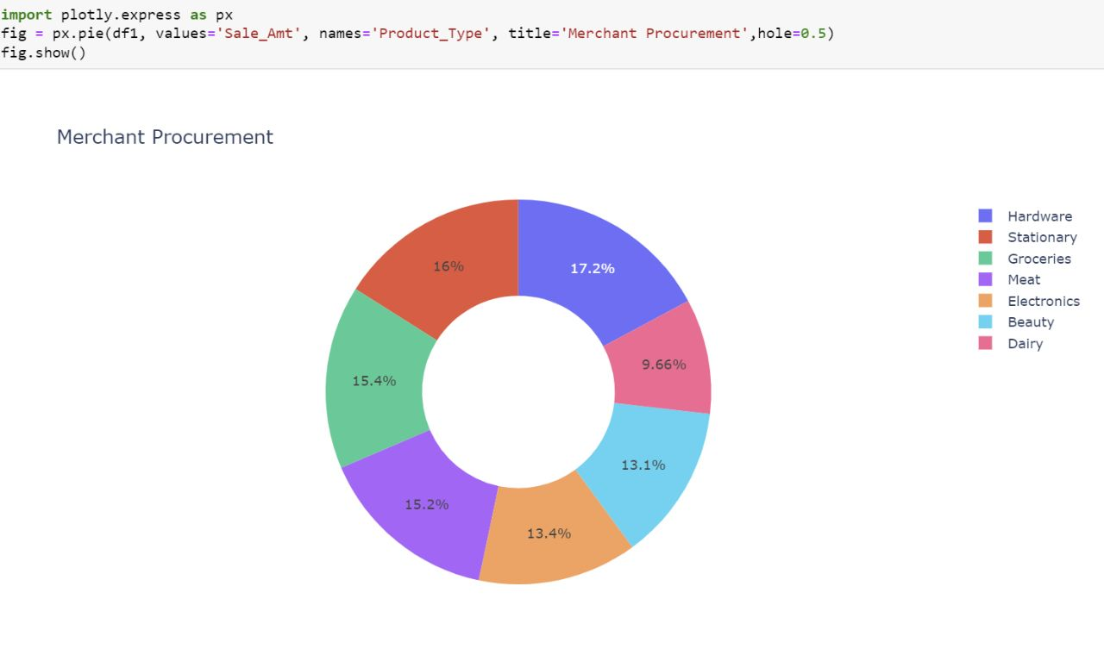

Slide 17
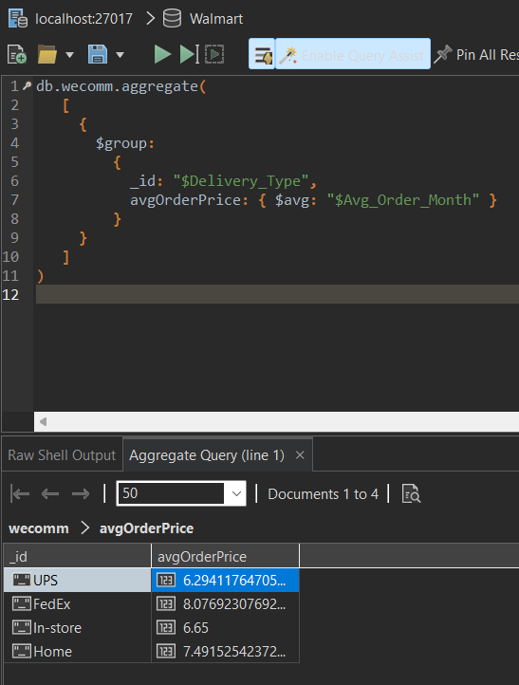
Walmart customers can choose their choice of Delivery Type from Home, In-store, UPS and Fed-Ex. The Board wanted to understand how the price of an average order placed varies with the type of delivery chosen by the customer.

Slide 18
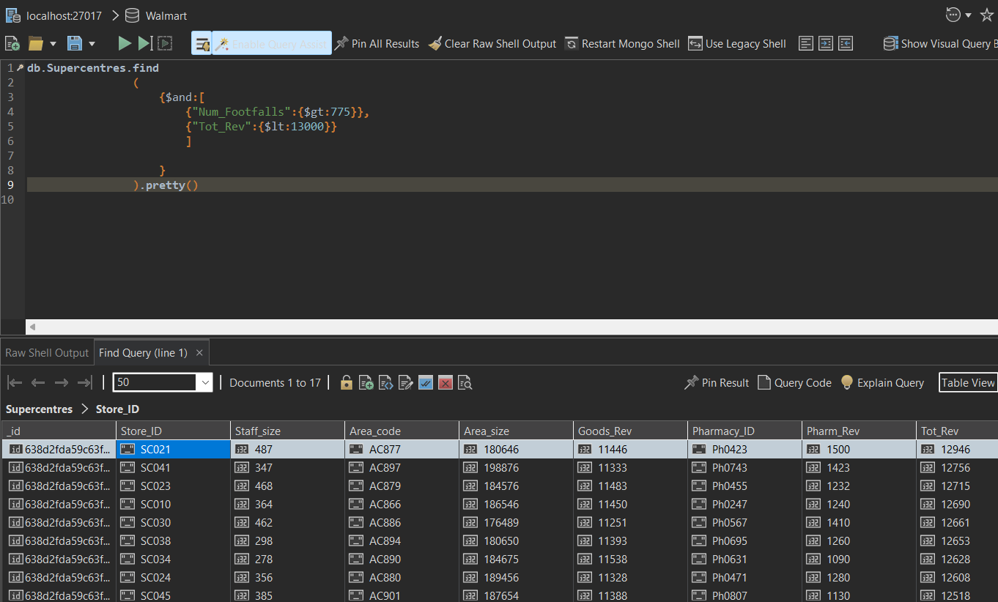
Board of Directors are worried if there is any case where customers are coming in (more Footfalls) But the revenue is not as expected.
Thus they wish to check for such cases where footfall is greater than 775 but total revenue less than 13000.

Slide 19
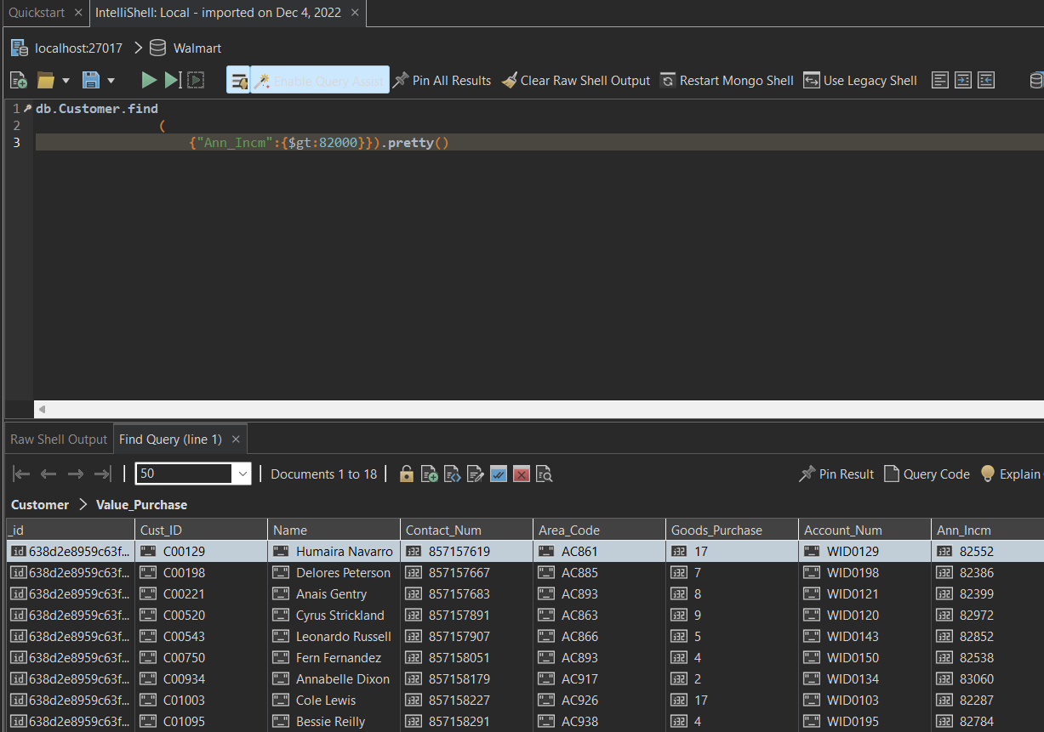
Survey - Walmart customer’s having annual income above the threshold of $82k agreed to buy a premium Walmart Plus package for getting early access to discounts & exclusive goods.

Slide 20
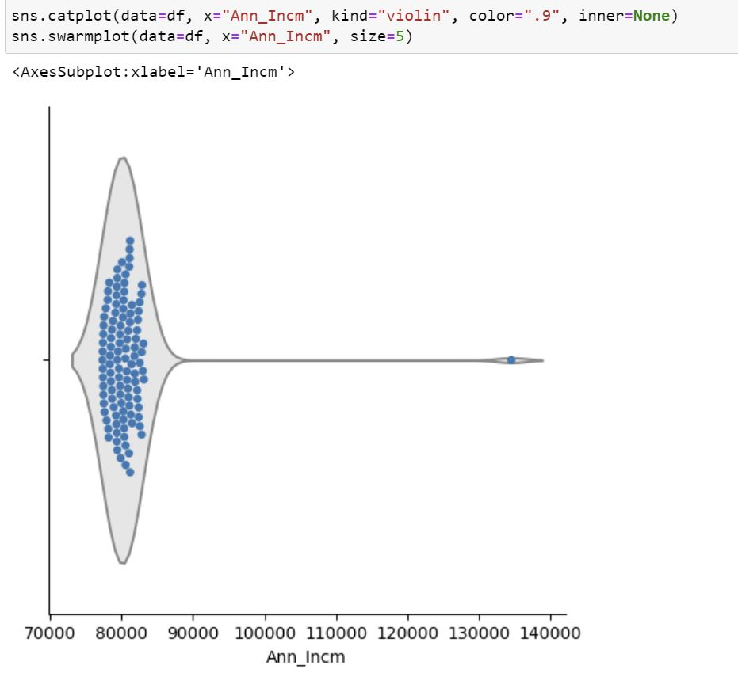

Slide 21
Thank You!
Looking forward for your feedback! Happy to learn and share :)

